Slide 1







Insights into Asthma Management
Identifying Key Risk Factors and Outcomes
Course: ALY6015 – Intermediate Analytics
Team: Capstone 3
A. S. Sushmitha Urs
Lavanya Suresh
Vaibhavi Bograj
Instructor: Richard He

Slide 2



Introduction
Asthma is a chronic inflammatory airway disease affecting millions worldwide, making it crucial to understand the factors that drive severity, hospital visits, and overall patient outcomes. This project analyzes the Synthetic Asthma Medical Dataset, a realistic dataset of 10,000 patient records with 17 demographic, lifestyle, environmental, and clinical features. It includes variables such as age, BMI, smoking status, physical activity, air pollution levels, FeNO, peak flow, medication adherence, and the number of emergency room (ER) visits. Together, these attributes provide a strong foundation for modeling asthma severity, predicting high-risk patients, and identifying key drivers of healthcare utilization.

Slide 3


Dataset Overview
Variables
The dataset contains 17 key features, including:
Demographic: Age, Gender, BMI, Family History
Lifestyle: Smoking Status, Physical Activity
Environmental: Air Pollution Level
Clinical: FeNO (airway inflammation marker), Peak Expiratory Flow, Comorbidities
Asthma Outcomes: Asthma Control Level, Number of ER Visits, Medication Adherence
Data Types
Numeric: Age, BMI, FeNO, Peak Flow
Categorical: Gender, Smoking Status, Comorbidities
Ordered Factors: Asthma Control Level, Air Pollution Level
Why This Dataset Is Useful?
Clean and structured, similar to real clinical data
Includes both predictors and outcomes required for severity modeling and risk prediction
Supports exploratory analysis, correlation assessment, ordinal regression, logistic modeling, and evaluating environmental or behavioral impacts on asthma

Slide 4



Research Questions
1.
What demographic, lifestyle, and environmental factors influence asthma severity?
2.
Can we predict likelihood of repeated ER visits (proxy for readmission)?
3.
How do medication adherence and air pollution jointly affect patient outcomes?

Slide 5
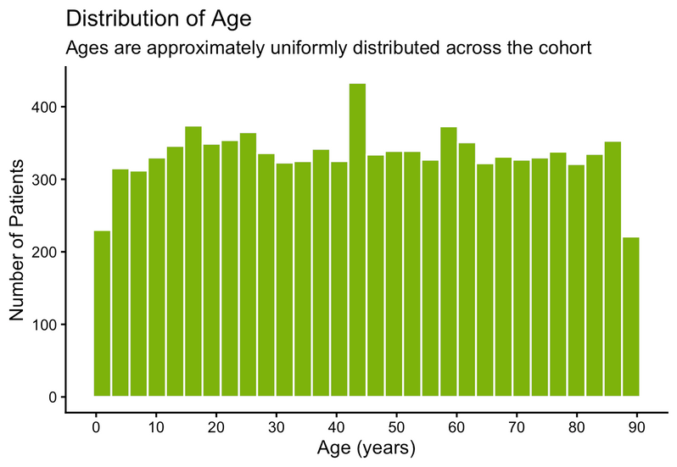
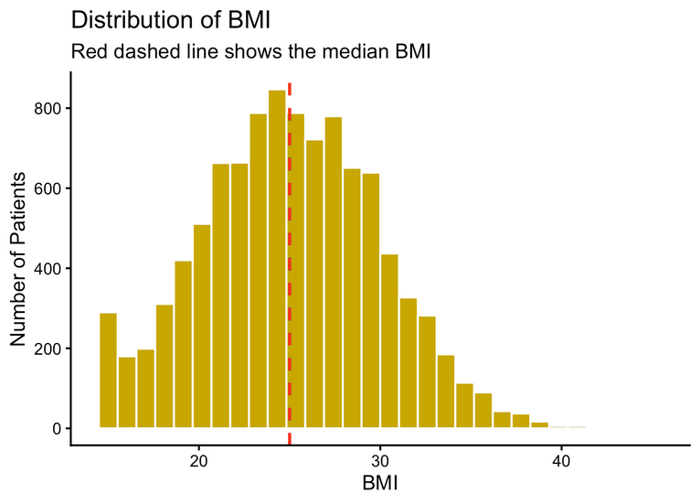
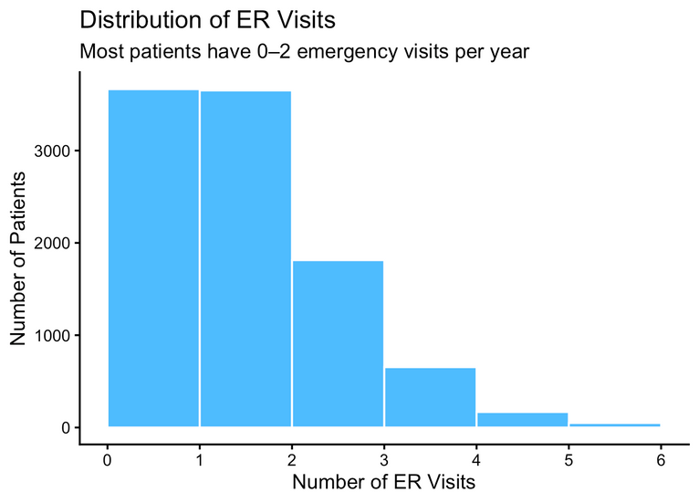


Dataset Characteristics - EDA
Key Patient Characteristics:
Age: 1-89 years (peak at 40-50)
Gender: Balanced (48% F, 48% M, 4% Other)
BMI: 15-45 kg/m² (mean 25)
Asthma Prevalence & Control:
24.3% have asthma (n=2,433)
Only 3.5% well-controlled
96.5% poorly/not controlled
Average 1 ER visit annually
Behavioral & Environmental:
60.7% never-smokers
49% moderate air pollution
Mean medication adherence: 50%
30% have family history

Slide 6
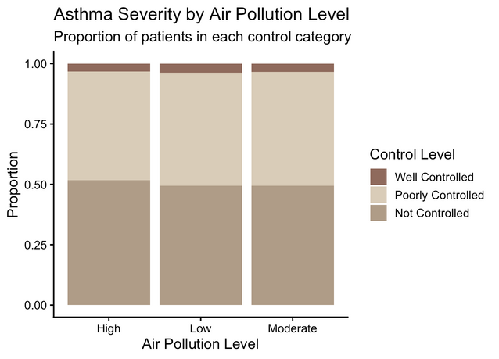
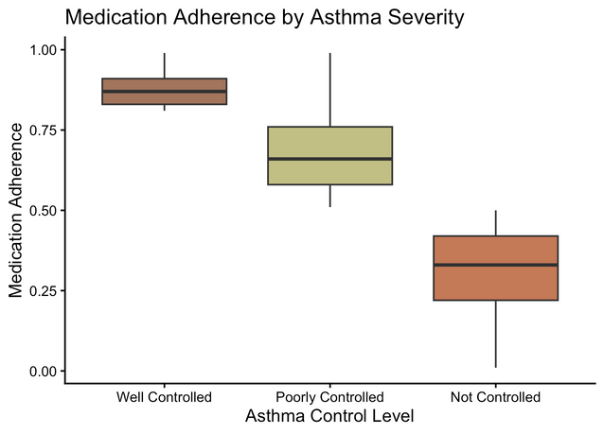
Research Question 1
1.
What demographic, lifestyle, and environmental factors influence asthma severity?
Method Used: Ordinal Logistic Regression (POLR)
Asthma Control Level has three ordered categories
(Well Controlled → Poorly Controlled → Not Controlled).
Ordinal Logistic Regression is the correct method when the outcome is ordered but not numeric.
Captures changes in severity across levels and estimates the direction & strength of predictors.
Key Results (Outputs)
Significant predictors:
o Higher Air Pollution → higher odds of poor control
o Lower Medication Adherence → worse severity
o Smoking Status, BMI, Age, and Comorbidities also significant
Interpretation:
Patients with low adherence and high pollution exposure are much more likely to fall into poorly or not-controlled asthma categories.

Slide 7
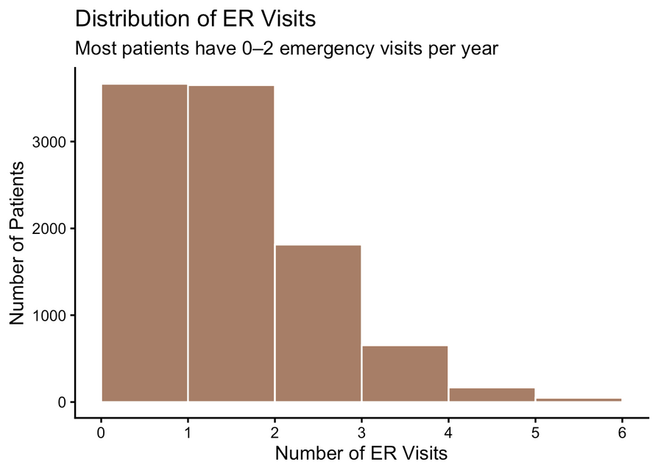

Research Question 2
2.
Can we predict likelihood of repeated ER visits (proxy for readmission)?
Method Used: Binary Logistic Regression
Outcome variable: Multiple ER Visits (2+ per year)
Binary outcome makes logistic regression the correct method
Estimates probability of high healthcare utilization

Slide 8
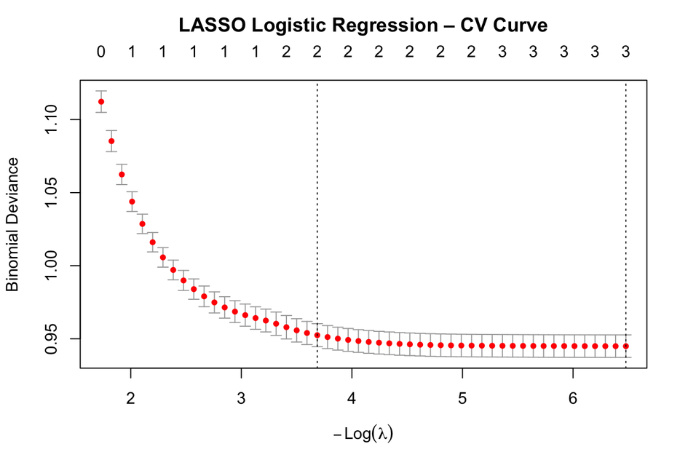
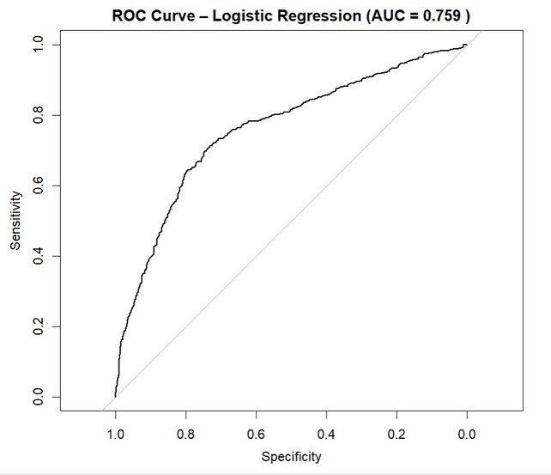
Research Question 2
2.
Key Results:
High FeNO, low medication adherence, smoking, comorbidities, and high pollution significantly increase the odds of repeated ER visits
Model performance: AUC ≈ 0.759 (good predictive power)
LASSO logistic regression was used for variable selection and showed similar AUC.

Slide 9
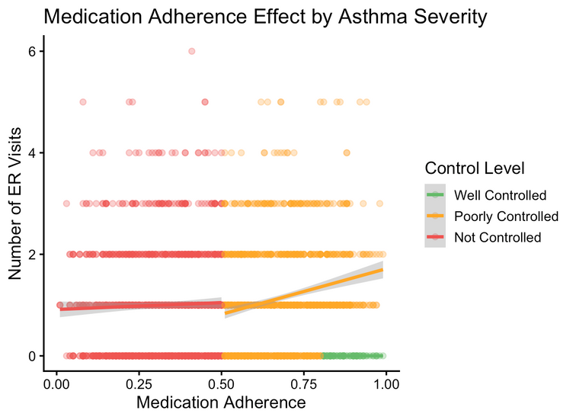
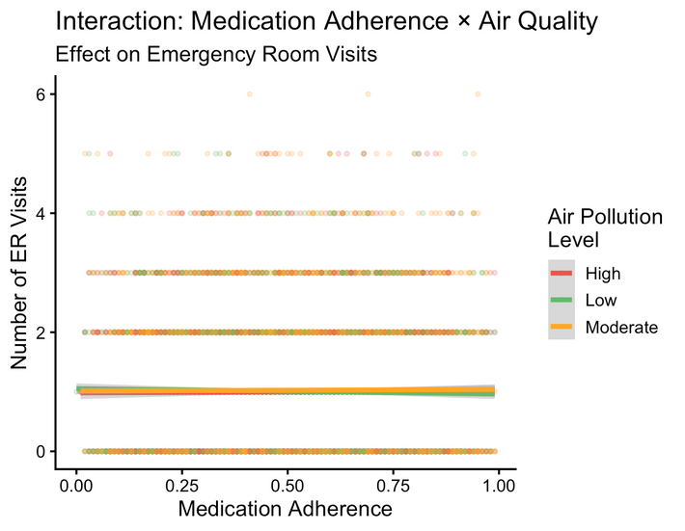

Research Question 3
3.
How do medication adherence and air pollution jointly affect patient outcomes?
Method Used:
Linear Regression with Interaction Term
Poisson Regression for validation (count outcome)
Key Results:
Interaction term is statistically significant
High pollution weakens the benefit of medication adherence
Patients with low adherence under high pollution conditions show the highest ER visit rates

Slide 10

Non-Parametric Methods Overview
Why Non-Parametric Tests?
Many variables (ER visits, FeNO, BMI) are skewed or ordinal.
Non-parametric methods do not assume normality and are ideal for clinical data.
Used to compare groups and check associations when parametric assumptions fail.
Tests Used
1. Kruskal–Wallis Test
Compared ER visits across asthma severity groups.
Result: Significant differences → worse severity = more ER visits.
2. Pairwise Wilcoxon Tests
Compared each severity group pair.
All comparisons significant.
3. Wilcoxon Rank-Sum (BMI vs Asthma)
Tested BMI differences between asthma and non-asthma patients.
Result: Significant difference in BMI across groups.

Slide 11



Conclusion
Key Predictors Identified:
Air pollution, medication adherence, BMI, smoking status, FeNO levels, and comorbidities were found to significantly influence asthma severity and ER visit frequency.
Strong Predictive Performance:
The models effectively identified high-risk patients, and interaction analysis revealed that poor air quality weakens the positive impact of good medication adherence.
Future Enhancement Opportunities:
Incorporating time-series data, real hospital readmission records, broader environmental variables, and developing a real-time predictive dashboard can further strengthen asthma risk monitoring and personalized patient management.

Slide 12
References
Synthetic Asthma Dataset (2025). Asthma Management – Identifying Key Risk Factors and Outcomes. Kaggle.
Field, A. (2017). Discovering Statistics Using R. Sage Publications.
Centers for Disease Control and Prevention (CDC). Asthma Data & Surveillance (2024).

Slide 13

Thank You

